Slide 1
CATIA V5R21 Persistent Naming
11 April 2018
Soonjo Kwon, Imgyu Kim
iCAD

Slide 2
Document History
16-05-18_Soonjo Kwon_Draft
16-10-11_Soonjo Kwon_r1
4/11/2018 Imgyu Kim
–Add Instruction of CATScript for assembly model.

Slide 3
Table of Contents
CATIA Persistent Naming
Face Naming
Edge Naming
Key information
Sketch element
Naming mapping
Naming for assembly
Conclusion

Slide 4
CATIA Persistent Naming
CATIA uses topology-based persistent naming method
Face naming is the basis
Required Information for face naming
Face type (initial, lateral, terminal)
Feature name
Sketch name, Sketch element number
For edge or vertex, adjacent faces are used for naming
※ The following content is based on CATIA V5R21

Slide 5
Face Naming (1)
("Selection_RSur:( Face:(Brp:(Pad.1;2);None:();Cf11:()); Pad.1_ResultOUT;Z0;G4074)")
Face naming
Additional
Face naming
Key information
Recently created feature name

Slide 6
Face Naming (2)
("Selection_RSur:( Face:(Brp:(Pad.1;0:(Brp:(Sketch.1;4)));None:();Cf11:()); Pad.1_ResultOUT;Z0;G4074)")
Face naming
Additional
Face naming
Key information
Recently created feature name

Slide 7
Edge Naming (1)
("REdge:( Edge:( Face:(Brp:(Pad.1;0:(Brp:(Sketch.1;3)));None:();Cf11:()); Face:(Brp:(Pad.1;2);None:();Cf11:()); None:(Limits1:();Limits2:());Cf11:()); WithTemporaryBody;WithoutBuildError;WithSelectingFeatureSupport; MFBRepVersion_CXR15)", pad1)
edge
naming
First adjacent face naming
Second adjacent face naming
Additional
Edge naming
Face naming
Key information
Recently created feature name

Slide 8
Edge Naming (2)
("TgtEdge:(GeneratedEdges;MfIE_R20GA;TgtPropagationFillet; FirstOperands:(Pad.1);SecondOperands:();InitEdges:REdge:( Edge:( Face:(Brp:(Pad.1;0:(Brp:(Sketch.1;3)));None:();Cf11:()); Face:(Brp:(Pad.1;2);None:();Cf11:()); None:(Limits1:();Limits2:());Cf11:()); WithTemporaryBody;WithoutBuildError;WithSelectingFeatureSupport; MFBRepVersion_CXR15)))", pad1)
edge
naming
First adjacent face naming
Second adjacent face naming
Additional
Edge naming
Face naming
Key information
Recently created feature name
Feature name of the target body

Slide 9
Key information
(Pad.1;0:(Brp:(Sketch.1;3)))
Feature name
Face type
0 : lateral face
1 : initial (start) face
2 : terminal (end) face
Sketch information (In case of lateral faces)
Sketch name
Sketch element number (=ReportName)
(* Initial or terminal face requires no sketch information)
(** Need two sketch information for the features that require two sketches such as rib, slot)
(Rib.1;0:(Brp:(Sketch.1;4);Brp:(Sketch.2;3)))

Slide 10
Key information : Sketch element
ReportName is used to identify a sketch element
Dim line2D1 As Line2D
Set line2D1 = factory2D1.CreateLine(-20.000000, -20.000000, 20.000000, -20.000000)
line2D1.ReportName = 3
……
line2D2.ReportName = 4
……
line2D3.ReportName = 5
……
line2D4.ReportName = 6
An example of
CATIA macro
(Pad.1;2)
(Pad.1;0:(Brp:(Sketch.1;5)))
line2D3
(Pad.1;0:(Brp:(Sketch.1;6)))
(Pad.1;0:(Brp:(Sketch.1;4)))
Sketch.1
Create Pad.1
line2D4
line2D2
line2D1
(Pad.1;0:(Brp:(Sketch.1;3)))
(Pad.1;1)

Slide 11
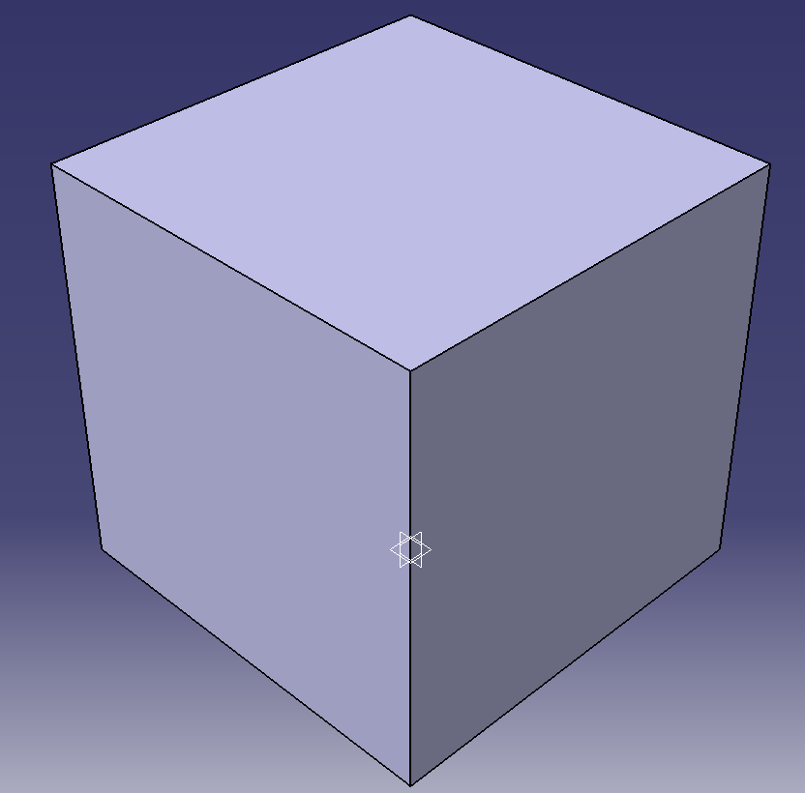

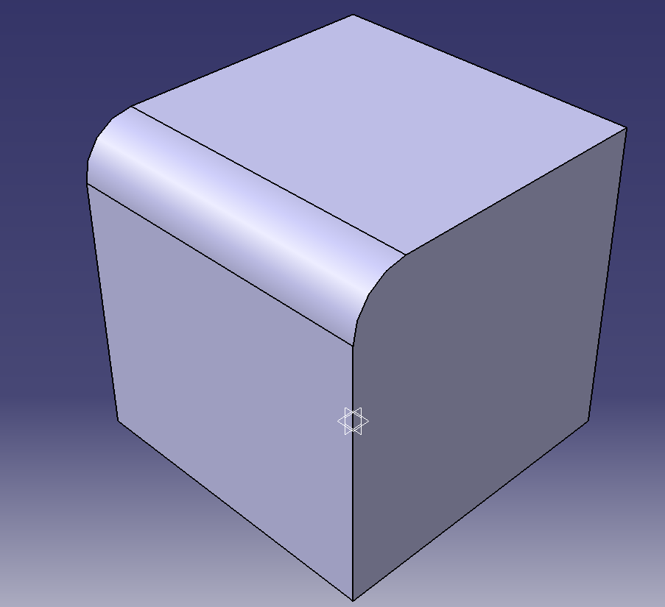
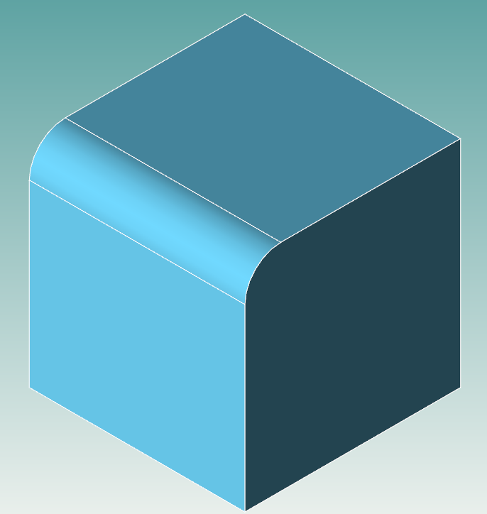
Naming mapping
Naming mapping is necessary for translating reference elements such as face, edge, vertex
CATIA
TransCAD
Select an edge
TgtEdge:(GeneratedEdges;MfIE_R20GA;TgtPropagationFillet; FirstOperands:(Pad.1);SecondOperands:();InitEdges:(REdge:( Edge:( Face:(Brp:(Pad.1;0:(Brp:(Sketch.1;3)));None:();Cf11:()); Face:(Brp:(Pad.1;2);None:();Cf11:()); None:(Limits1:();Limits2:());Cf11:()); WithTemporaryBody;WithoutBuildError; WithSelectingFeatureSupport;MFBRepVersion_CXR15)))
mapping
Extrude1,Sketch1,Line3,0,0,0,ExtrudeFeature:0,0:0;0#
Extrude1,0,-2,0,0,0,ExtrudeFeature:0,0:0;0
Create a fillet

Slide 12
Conclusion
CATIA is using topology-based persistent naming
Face naming is the basis
Key information: Feature name, Face type, Sketch information
Sketch information consists of sketch name & sketch element number
ReportName is used to identify a sketch element (=sketch element number)
To understand the persistent naming method is the key for implementation
Naming mapping between two CAD systems is mandatory for translation

Slide 13
Conclusion
Please check all the face names of all the additive/subtractive features in CATIA
Use macro recording function
The naming rule of TransCAD is almost similar with the naming rule of CATIA
The naming method is thought to be version-independent, but please check if the naming method is the same when you upgrade CATIA

Slide 14
CATScript file for Assembly model
Language="VBSCRIPT"
Sub CATMain()
////////////////////////////////////////////////////////
/* Product Document 생성 */
////////////////////////////////////////////////////////
/* Part #1 Document 생성 */
////////////////////////////////////////////////////////
/* Part #1 Design */
…
////////////////////////////////////////////////////////
/* Part #n Document 생성 */
////////////////////////////////////////////////////////
/* Part #n Design */
////////////////////////////////////////////////////////
/* Assembly Design */
Constraint #1
Constraint #2
…
Constraint #n
////////////////////////////////////////////////////////
End Sub
Same as a case of part translator

Slide 15
CATScript file for Assembly model
Language="VBSCRIPT"
Sub CATMain()
////////////////////////////////////////////////////////
/* Product Document 생성 */
////////////////////////////////////////////////////////
/* Part #1 Document 생성 */
////////////////////////////////////////////////////////
/* Part #1 Design */
…
////////////////////////////////////////////////////////
/* Part #n Document 생성 */
////////////////////////////////////////////////////////
/* Part #n Design */
////////////////////////////////////////////////////////
/* Assembly Design */
Constraint #1
Constraint #2
…
Constraint #n
////////////////////////////////////////////////////////
End Sub
////////////////////////////////////////////////////////
/* Product Document 생성 */
Dim documents1 As Documents
Set documents1 = CATIA.Documents
Dim productDocument1 As Document
Set productDocument1 = documents1.Add("Product")
Dim product1 As Product
Set product1 = productDocument1.Product
Dim products1 As Products
Set products1 = product1.Products
////////////////////////////////////////////////////////

Slide 16
CATScript file for Assembly model
Language="VBSCRIPT"
Sub CATMain()
////////////////////////////////////////////////////////
/* Product Document 생성 */
////////////////////////////////////////////////////////
/* Part #1 Document 생성 */
////////////////////////////////////////////////////////
/* Part #1 Design */
…
////////////////////////////////////////////////////////
/* Part #n Document 생성 */
////////////////////////////////////////////////////////
/* Part #n Design */
////////////////////////////////////////////////////////
/* Assembly Design */
Constraint #1
Constraint #2
…
Constraint #n
////////////////////////////////////////////////////////
End Sub
////////////////////////////////////////////////////////
/* Part Document 생성 */
Dim product2 As Product
Set product2 = products1.AddNewComponent("Part", "")
Dim partDocument1 As Document
Set partDocument1 = documents1.Item("Part1.CATPart")
Dim part1 As Part
Set part1 = partDocument1.Part
Dim bodies1 As Bodies
Set bodies1 = part1.Bodies
Dim body1 As Body
Set body1 = bodies1.Item("PartBody")
////////////////////////////////////////////////////////
/* Part Design */
Dim sketches1 As Sketches
Set sketches1 = body1.Sketches
... 생략
part1.Update
////////////////////////////////////////////////////////
주의!
모든 Entities의 numbering이 중복되면 안됨.

Slide 17
CATScript file for Assembly model
Language="VBSCRIPT"
Sub CATMain()
////////////////////////////////////////////////////////
/* Product Document 생성 */
////////////////////////////////////////////////////////
/* Part #1 Document 생성 */
////////////////////////////////////////////////////////
/* Part #1 Design */
…
////////////////////////////////////////////////////////
/* Part #n Document 생성 */
////////////////////////////////////////////////////////
/* Part #n Design */
////////////////////////////////////////////////////////
/* Assembly Design */
Constraint #1
Constraint #2
…
Constraint #n
////////////////////////////////////////////////////////
End Sub
Dim constraints1 As Collection
Set constraints1 = product1.Connections("CATIAConstraints")
Dim reference1 As Reference
Set reference1 = product1.CreateReferenceFromName(“…”)
Dim reference2 As Reference
Set reference2 = product1.CreateReferenceFromName(“…”)
Dim constraint1 As Constraint
Set constraint1 = constraints1.AddBiEltCst(catCstTypeSurfContact, reference1, reference2)
Set constraints1 = product1.Connections("CATIAConstraints")
Dim reference3 As Reference
Set reference3 = product1.CreateReferenceFromName(“…”)
Dim reference4 As Reference
Set reference4 = product1.CreateReferenceFromName(“…”)
Dim constraint2 As Constraint
Set constraint2 = constraints1.AddBiEltCst(catCstTypeOn, reference3, reference4)
product1.Update

Slide 18
CATScript file for Assembly model
Language="VBSCRIPT"
Sub CATMain()
////////////////////////////////////////////////////////
/* Product Document 생성 */
////////////////////////////////////////////////////////
/* Part #1 Document 생성 */
////////////////////////////////////////////////////////
/* Part #1 Design */
…
////////////////////////////////////////////////////////
/* Part #n Document 생성 */
////////////////////////////////////////////////////////
/* Part #n Design */
////////////////////////////////////////////////////////
/* Assembly Design */
Constraint #1
Constraint #2
…
Constraint #n
////////////////////////////////////////////////////////
End Sub
Dim constraints1 As Collection
Set constraints1 = product1.Connections("CATIAConstraints")
Dim reference1 As Reference
Set reference1 = product1.CreateReferenceFromName(“…”)
Dim reference2 As Reference
Set reference2 = product1.CreateReferenceFromName(“…”)
Dim constraint1 As Constraint
Set constraint1 = constraints1.AddBiEltCst(catCstTypeSurfContact, reference1, reference2)
Set constraints1 = product1.Connections("CATIAConstraints")
Dim reference3 As Reference
Set reference3 = product1.CreateReferenceFromName(“…”)
Dim reference4 As Reference
Set reference4 = product1.CreateReferenceFromName(“…”)
Dim constraint2 As Constraint
Set constraint2 = constraints1.AddBiEltCst(catCstTypeOn, reference3, reference4)
product1.Update

Slide 19
CATIA Macro… for Assembly
Language="VBSCRIPT"
Sub CATMain()
////////////////////////////////////////////////////////
/* Product Document 생성 */
////////////////////////////////////////////////////////
/* Part #1 CATPart 불러오기 */
////////////////////////////////////////////////////////
/* Part #2 CATPart 불러오기 */
…
////////////////////////////////////////////////////////
/* Part #N CATPart 불러오기 */
////////////////////////////////////////////////////////
/* Assembly Design */
Constraint #1
Constraint #2
…
Constraint #n
////////////////////////////////////////////////////////
End Sub

Slide 20
CATIA Macro… for Assembly
Language="VBSCRIPT"
Sub CATMain()
////////////////////////////////////////////////////////
/* Product Document 생성 */
////////////////////////////////////////////////////////
/* Part #1 CATPart 불러오기 */
////////////////////////////////////////////////////////
/* Part #2 CATPart 불러오기 */
…
////////////////////////////////////////////////////////
/* Part #N CATPart 불러오기 */
////////////////////////////////////////////////////////
/* Assembly Design */
Constraint #1
Constraint #2
…
Constraint #n
////////////////////////////////////////////////////////
End Sub
///////////////////////////////////////////////////////////////////////////////////////////////////
/* Part #1 CATPart 불러오기 */
Dim arrayOfVariantOfBSTR1(0)
arrayOfVariantOfBSTR1(0) = "C:\Users\Imgyu Kim… *.CATPart"
products1.AddComponentsFromFiles arrayOfVariantOfBSTR1, "All"
///////////////////////////////////////////////////////////////////////////////////////////////////

Slide 21
CATScript for Assembly model
Language="VBSCRIPT"
Sub CATMain()
////////////////////////////////////////////////////////
/* Product Document 생성 */
////////////////////////////////////////////////////////
/* Part #1 Document 생성 */
////////////////////////////////////////////////////////
/* Part #1 Design */
…
////////////////////////////////////////////////////////
/* Part #n Document 생성 */
////////////////////////////////////////////////////////
/* Part #n Design */
////////////////////////////////////////////////////////
/* Assembly Design */
Constraint #1
Constraint #2
…
Constraint #n
////////////////////////////////////////////////////////
End Sub
Dim constraints1 As Collection
Set constraints1 = product1.Connections("CATIAConstraints")
Dim reference1 As Reference
Set reference1 = product1.CreateReferenceFromName(“…”)
Dim reference2 As Reference
Set reference2 = product1.CreateReferenceFromName(“…”)
Dim constraint1 As Constraint
Set constraint1 = constraints1.AddBiEltCst(catCstTypeSurfContact, reference1, reference2)
Set constraints1 = product1.Connections("CATIAConstraints")
Dim reference3 As Reference
Set reference3 = product1.CreateReferenceFromName(“…”)
Dim reference4 As Reference
Set reference4 = product1.CreateReferenceFromName(“…”)
Dim constraint2 As Constraint
Set constraint2 = constraints1.AddBiEltCst(catCstTypeOn, reference3, reference4)
product1.Update

Slide 22
CATScript for Assembly model
Language="VBSCRIPT"
Sub CATMain()
////////////////////////////////////////////////////////
/* Product Document 생성 */
////////////////////////////////////////////////////////
/* Part #1 Document 생성 */
////////////////////////////////////////////////////////
/* Part #1 Design */
…
////////////////////////////////////////////////////////
/* Part #n Document 생성 */
////////////////////////////////////////////////////////
/* Part #n Design */
////////////////////////////////////////////////////////
/* Assembly Design */
Constraint #1
Constraint #2
…
Constraint #n
////////////////////////////////////////////////////////
End Sub
Dim constraints1 As Collection
Set constraints1 = product1.Connections("CATIAConstraints")
Dim reference1 As Reference
Set reference1 = product1.CreateReferenceFromName(“…”)
Dim reference2 As Reference
Set reference2 = product1.CreateReferenceFromName(“…”)
Dim constraint1 As Constraint
Set constraint1 = constraints1.AddBiEltCst(catCstTypeSurfContact, reference1, reference2)
Set constraints1 = product1.Connections("CATIAConstraints")
Dim reference3 As Reference
Set reference3 = product1.CreateReferenceFromName(“…”)
Dim reference4 As Reference
Set reference4 = product1.CreateReferenceFromName(“…”)
Dim constraint2 As Constraint
Set constraint2 = constraints1.AddBiEltCst(catCstTypeOn, reference3, reference4)
product1.Update

Slide 23
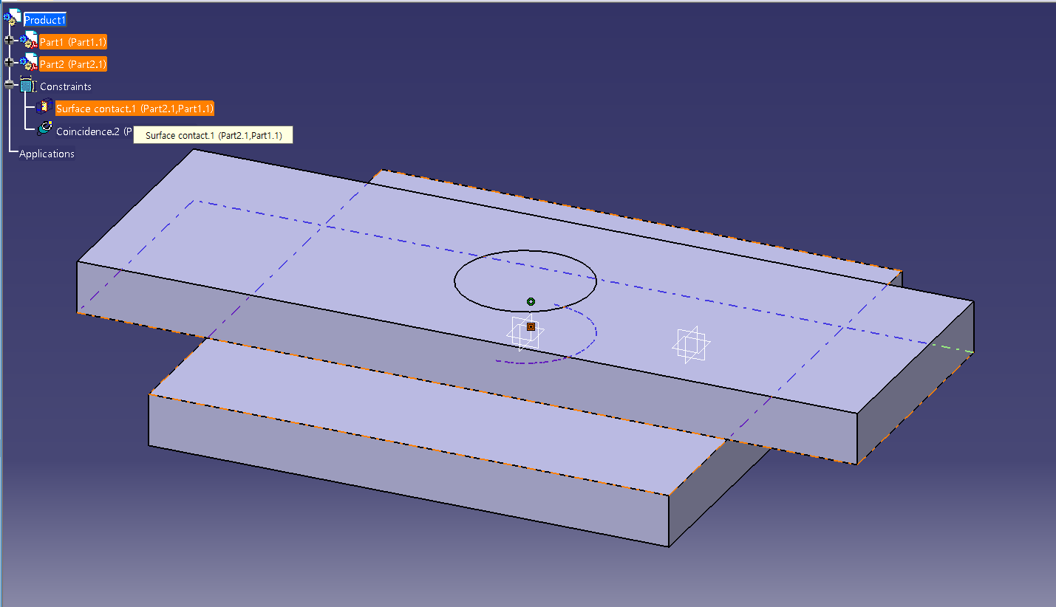
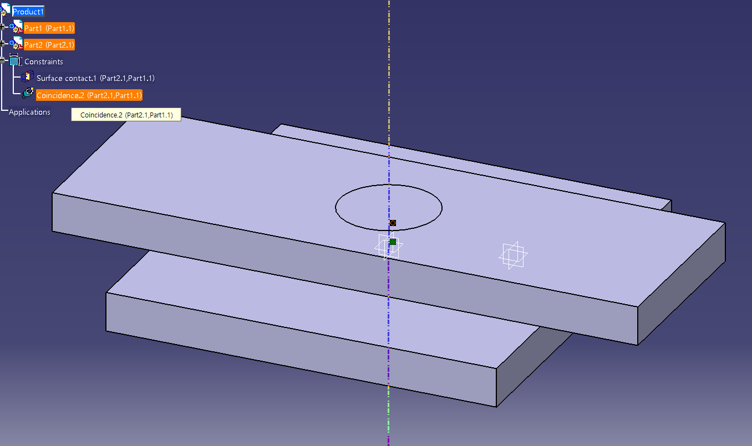
Translation of references for constraints
SubAssembly1,RotationPart,Extrude1,0,-1,0,0,0,ExtrudeFeature:0,0:0;0
SubAssembly1,Body,Extrude1,0,-2,0,0,0,ExtrudeFeature:0,0:0;0
TransCAD
“Product1/Part2.1/!Selection_RSur:(Face:(Brp:(Pad.1;1);None:();Cf11:());Pocket.1_ResultOUT;Z0;G4162)"
“Product1/Part1.1/!Selection_RSur:(Face:(Brp:(Pad.1;2);None:();Cf11:());Pad.2_ResultOUT;Z0;G4162)"
CATIA
Incidence constraint
Coaxial
"Product1/Part2.1/!Axis:(Selection_RSur:(Face:(Brp:(Pocket.1;0:(Brp:(Sketch.2;1)));None:();Cf11:());Pocket.1_ResultOUT;Z0;G4162))"
"Product1/Part1.1/!Axis:(Selection_RSur:(Face:(Brp:(Pad.2;0:(Brp:(Sketch.2;1)));None:();Cf11:());Pad.2_ResultOUT;Z0;G4162))"
CATIA
SubAssembly1,RotationPart,Cut1,Sketch2,Circle1,0,0,0,ExtrudeFeature:0,0:0;0
SubAssembly1,Body,Extrude2,Sketch2,Circle1,0,0,0,ExtrudeFeature:0,0:0;0
TransCAD

